Slide 1
NMT Decoding Bias Minimum Bayesian Risk
徐嘉豪

Slide 2
Content
Meister, Clara, Ryan Cotterell, and Tim Vieira. "If beam search is the answer, what was the question?." Proceedings of the 2020 Conference on Empirical Methods in Natural Language Processing (EMNLP). 2020.
Eikema, Bryan, and Wilker Aziz. "Is MAP Decoding All You Need? The Inadequacy of the Mode in Neural Machine Translation." Proceedings of the 28th International Conference on Computational Linguistics. 2020.
Müller, Mathias, and Rico Sennrich. "Understanding the Properties of Minimum Bayes Risk Decoding in Neural Machine Translation." Proceedings of the 59th Annual Meeting of the Association for Computational Linguistics and the 11th International Joint Conference on Natural Language Processing (Volume 1: Long Papers). 2021.

Slide 3
If beam search is the answer, what was the question

Slide 4
Core Idea
Beam search is a classic decoding algorithm in NMT research. Although beam search suffers from lots of problems (i.e. beam size curse), but it still works pretty well.
Uniform Information Density (UID). A phenomenon that people tends to speak a sentence with uniform distribution of information.
>How big is [NP the familyi [RC (that) you cook for −i]]? >People tend to speak word “that” out.
Because Beam search is a MAP decoding algorithm, it implicitly balance the information thus to generate output in UID manner.

Slide 5
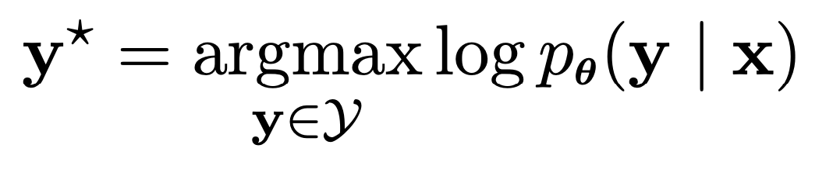
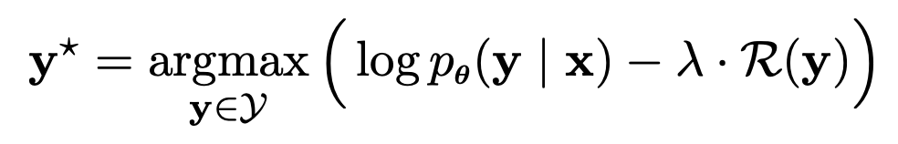
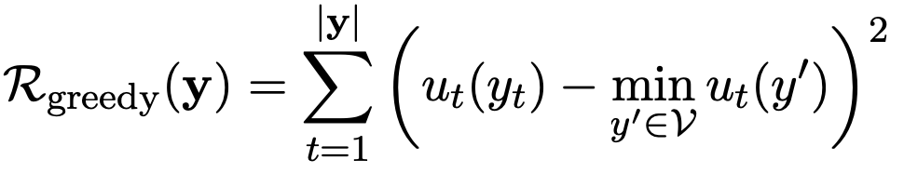
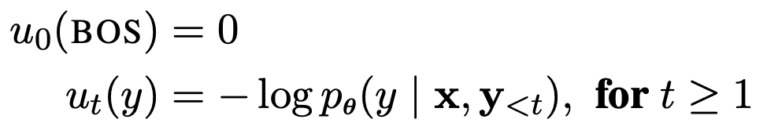
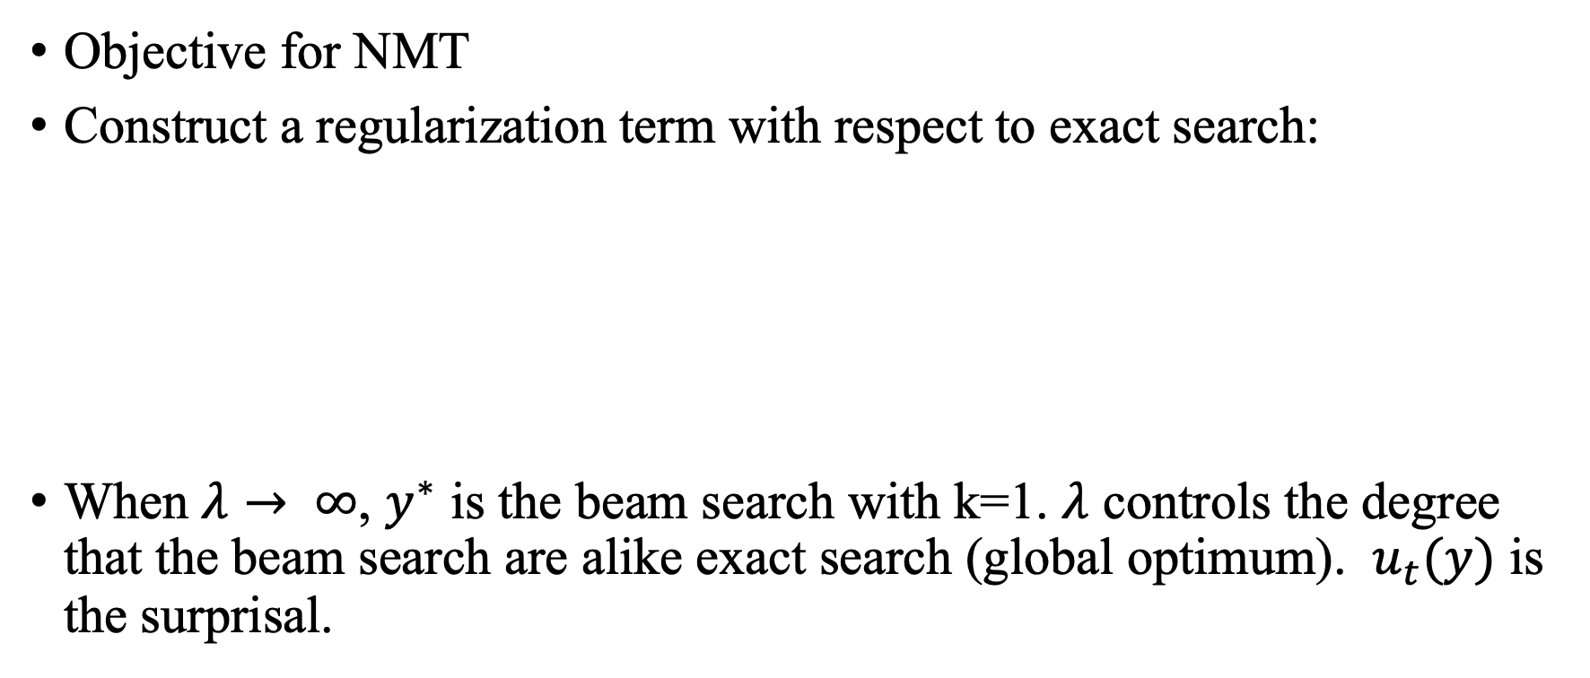
Research Flow
Objective for NMT
Construct a regularization term with respect to exact search:
When $λ→ ∞$, $y^{∗}$ is the beam search with k=1. $λ$ controls the degree that the beam search are alike exact search (global optimum). $u_{t}(y)$ is the surprisal.

Slide 6
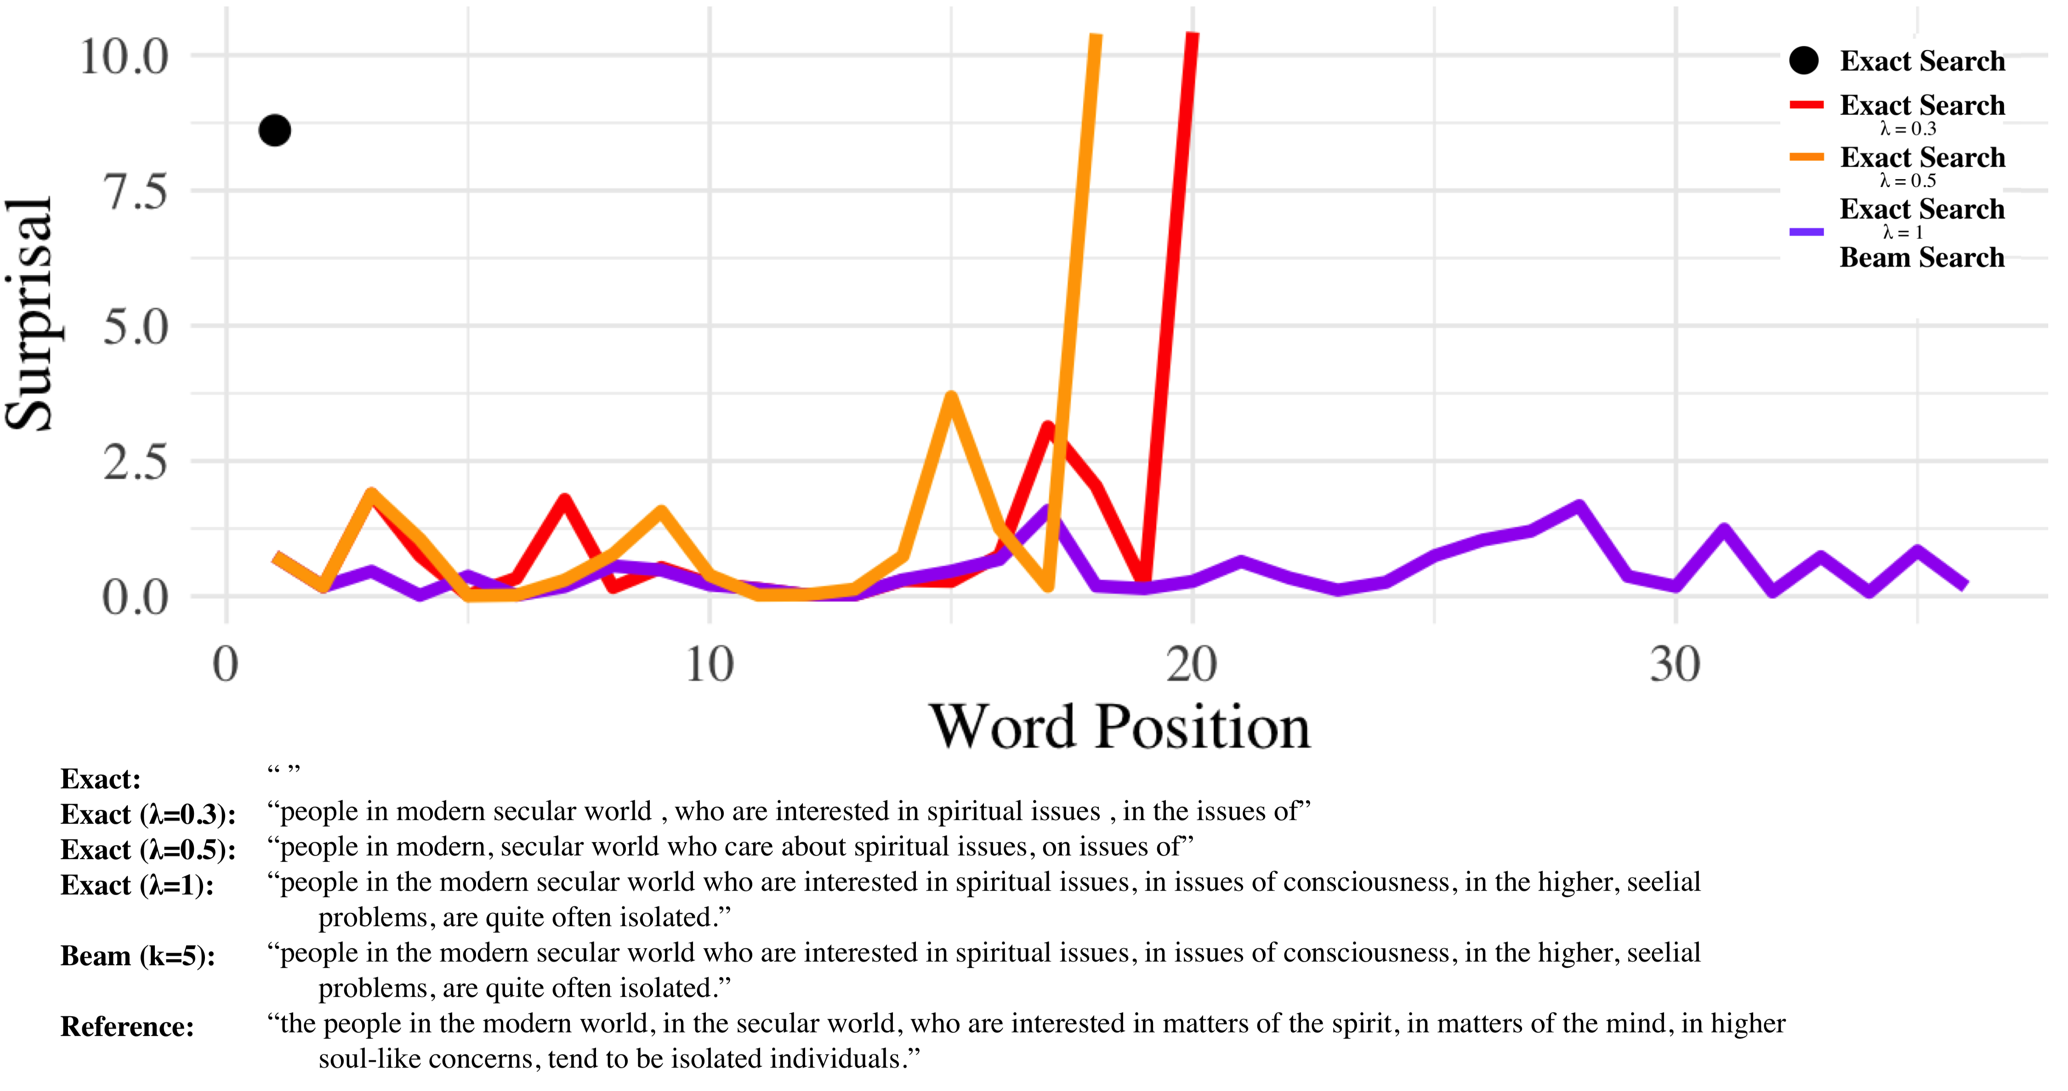
Case Study

Slide 7
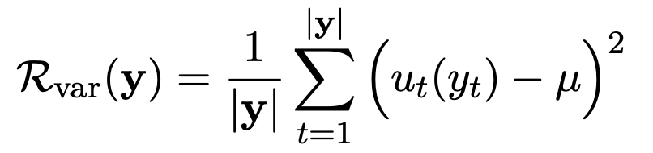
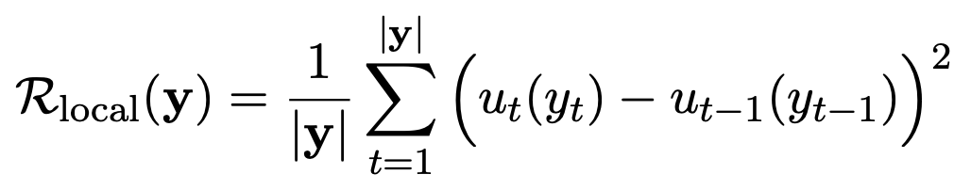
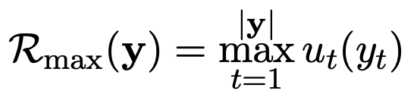
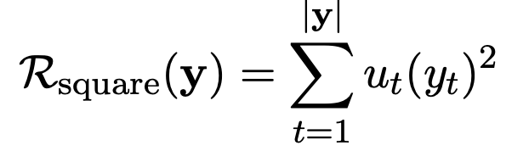
Regularization Term
Original Beam Search
Variance Regularizer.
Local Consistency.
Max Regularizer.
Squared Regularizer.

Slide 8
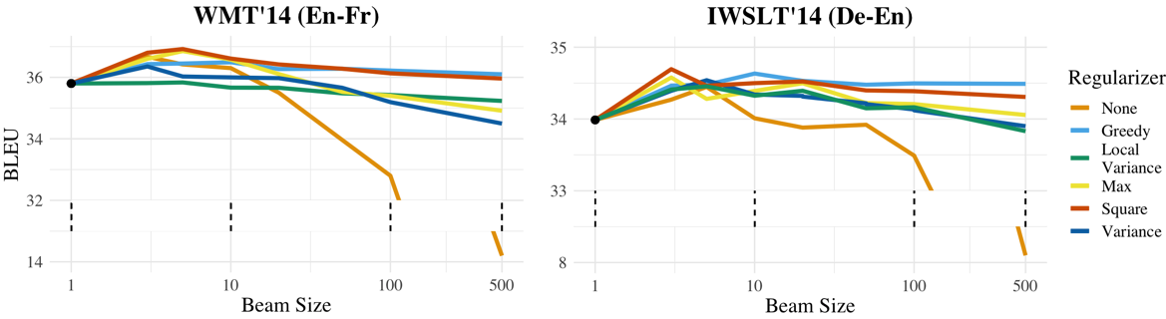
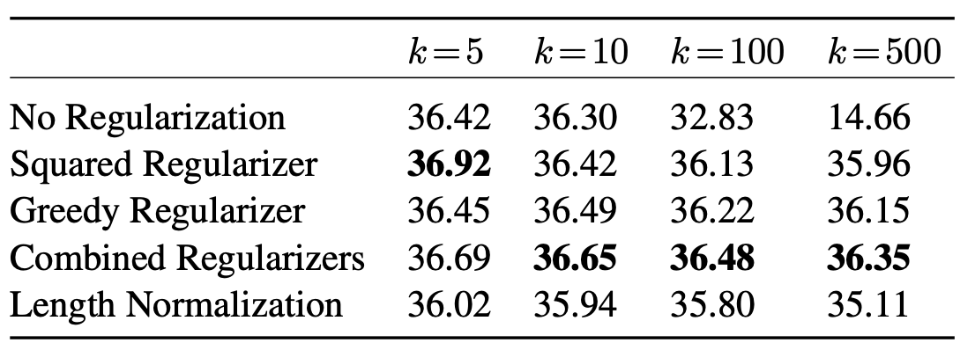
Experimnets

Slide 9
Conclusion
Provide a heuristic answer for beam search bless.
Research Flow:
Analysis beam search with respect to exact search.

Slide 10
Is MAP Decoding All You Need?
Best paper of COLING 2020.

Slide 11
Core Idea
Pathologies in NMT:
length bias: NMT underestimates length
beam search curse: large beam sizes hurt performance in NMT
…
Author argue that those problem is not the NMT training problem, but the beam search decoding problem.
Beam search is MAP decoding, which aims to maximum a prior. It always chooses the mode results to maximize the prior.

Slide 12
Estimate NMT without beam: Sampling
Estimate the NMT learning results by its prediction expectation instead of beam search, thus using sampling to generate the outputs.
Author build a hierarchical Bayesian model to estimate the beam, sampling and reference distribution.

Slide 13
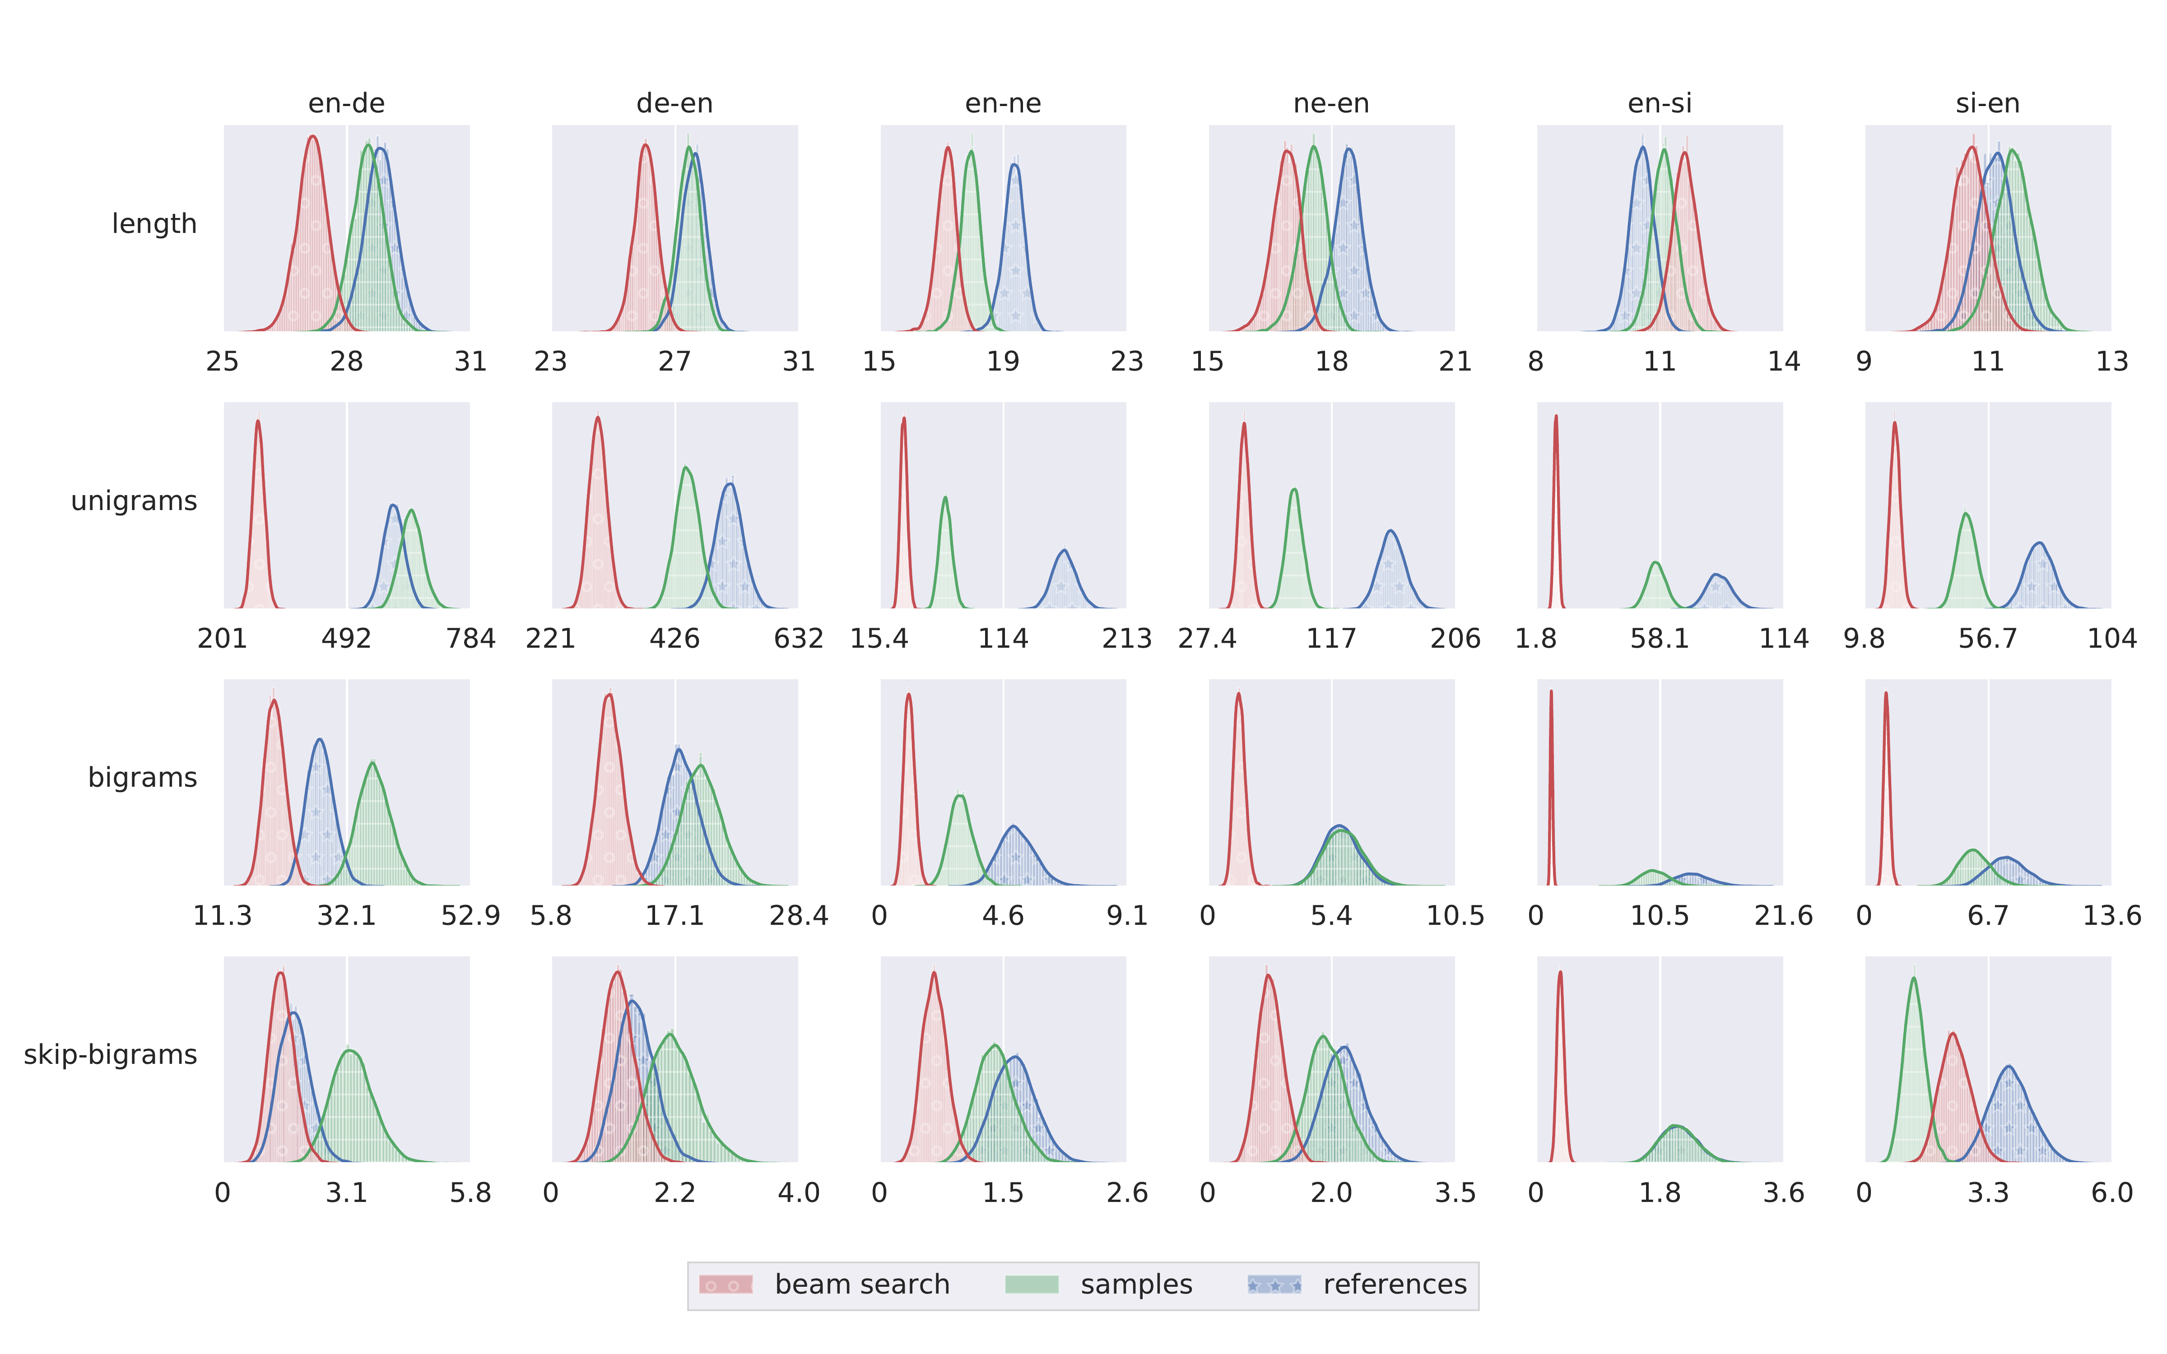
Results
It shows, in the most cases, beam search has larger bias than sampling.

Slide 14
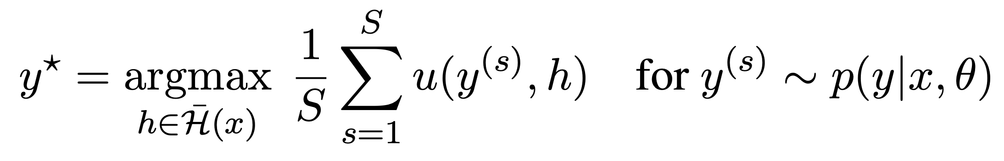
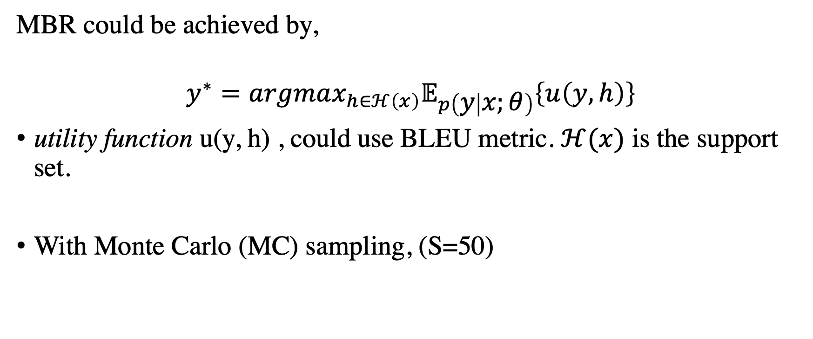
Minimum Bayes Risk Decoding
MBR could be achieved by,
$$y^{∗}=argmax_{h∈ℋ\left(x\right)}𝔼_{p\left(y | x;θ\right)}\left\{u\left(y,h\right)\right\}$$
utility function u(y, h) , could use BLEU metric. $ℋ(x)$ is the support set.
With Monte Carlo (MC) sampling, (S=50)

Slide 15
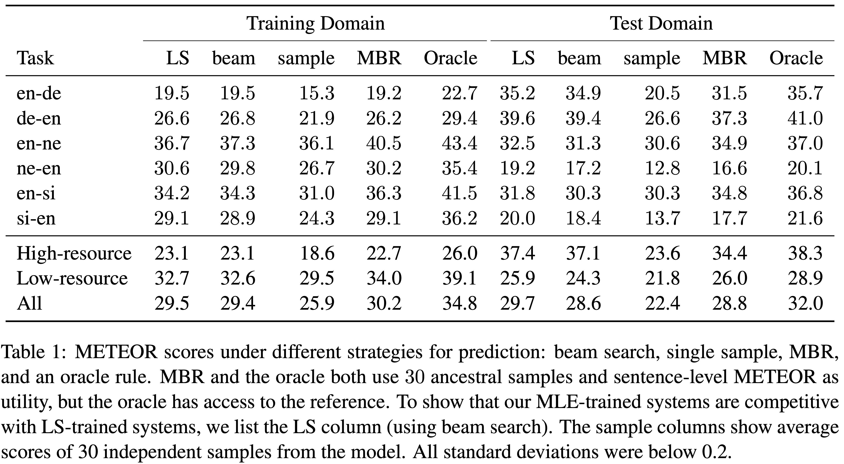
Experiment

Slide 16
Conclusion
NMT suffers from beam search biases, instead of Maximum Likelihood learning objective.
Such a bias could be avoided by MC estimation on MBR decoding.
>MBR is not a decoding algorithm without any constraint on path selection. (purely based on sampling)
>MBR still different from top-k sampling or top-P sampling (has bias).
>MBR utility function involves evaluation bias (i.e. BLEU metric, COMET metric, etc.)

Slide 17
Understanding the Properties of Minimum Bayes Risk Decoding in Neural Machine Translation
Mathias Muller and Rico Sennrich

Slide 18
Core Idea
length and token frequency bias
MT metrics used as utility functions
If used with a utility function that favours short translations, MBR inherits this bias;
MBR still exhibits a token probability bias in that it underestimates the probability of rare to- kens and overestimates very common tokens;
MBR increases robustness against copy noise and domain shift.
Empirically Study MBR Decoding

Slide 19
Bias
Length bias: Systems underestimate the true length of translations.
Word frequencies : Systems prefer frequent tokens
Beam search curse: large beam sizes decrease quality
Susceptibility to copy noise: copies of the source sentence on the target side of the training data (Khayrallah and Koehn, 2018).
Low domain robustness: not robust for distribution shifts
Inadequacy of the mode: mode of the distribution over output sequences is not the best translation.

Slide 20
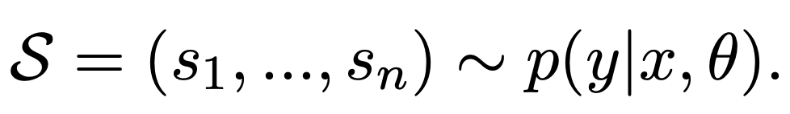
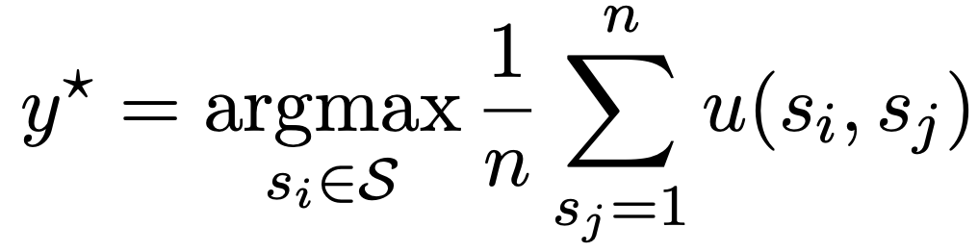
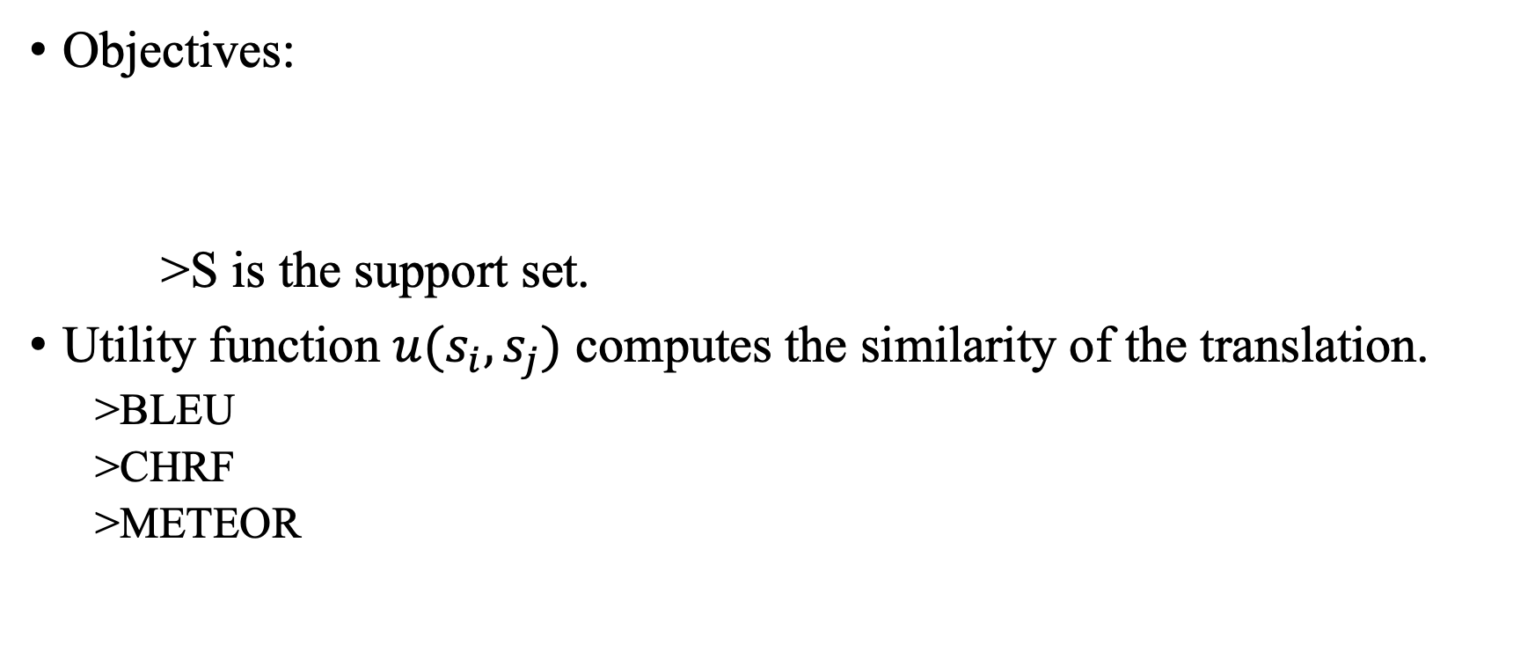
Minimum Bayes Risk Decoding
Objectives:
>S is the support set.
Utility function $u(s_{i}, s_{j})$ computes the similarity of the translation.
>BLEU
>CHRF
>METEOR

Slide 21
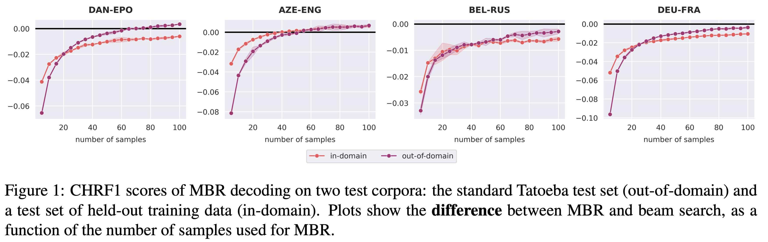
Compared with Beam

Slide 22
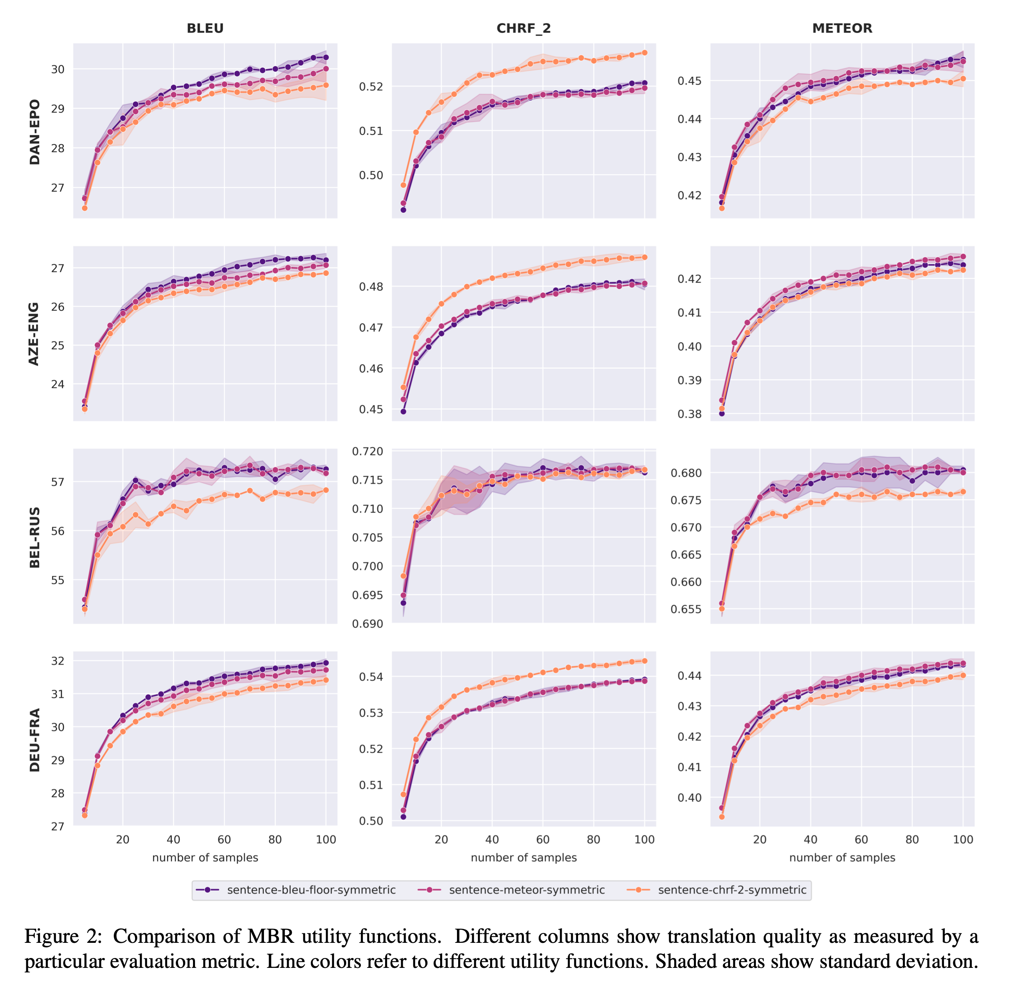
Utility Function
>MBR suffers from utility function bias which will further affect evaluation metric results by different type of metrics

Slide 23
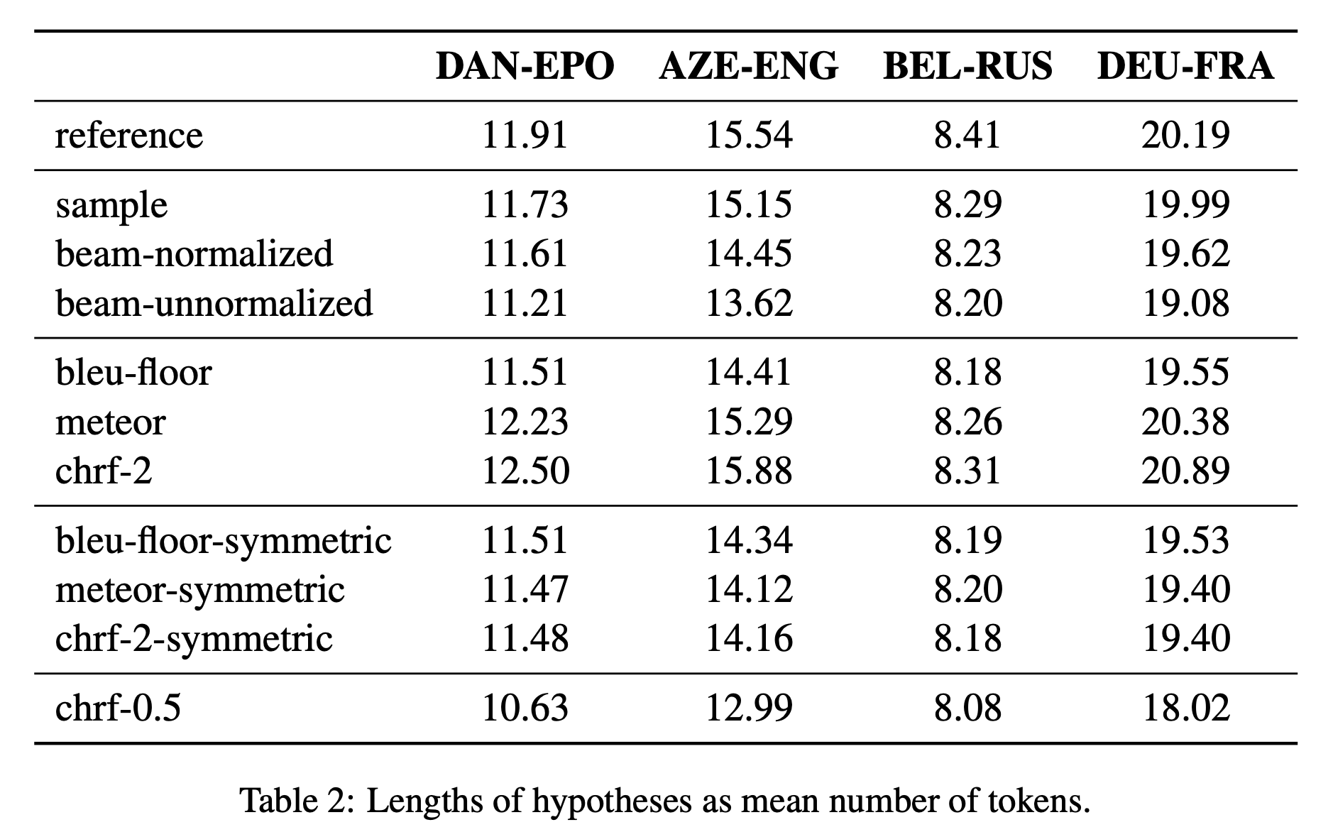
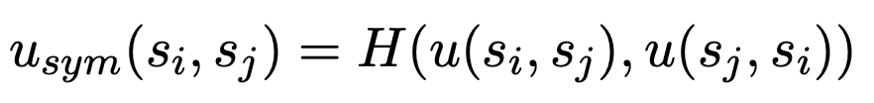
Length Bias
Conclusion: MBR inherits length biases associated with its utility function.

Slide 24
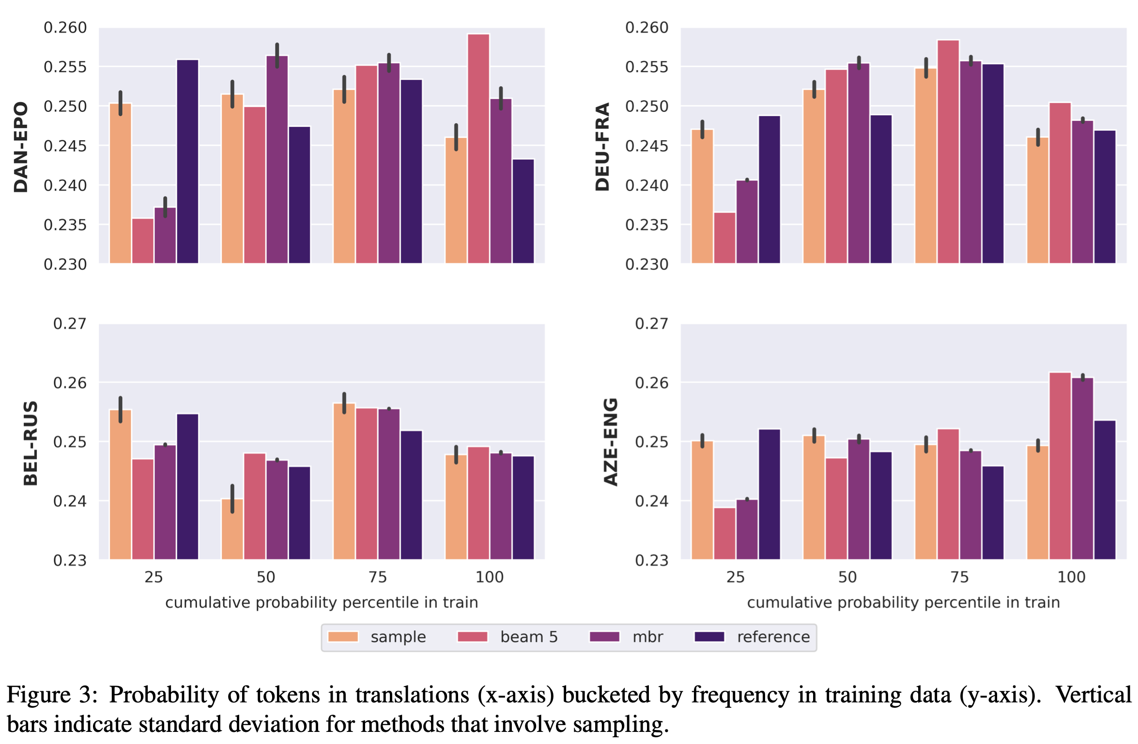
Token Frequency Bias
MBR still assigns too high a probability to frequent events.

Slide 25
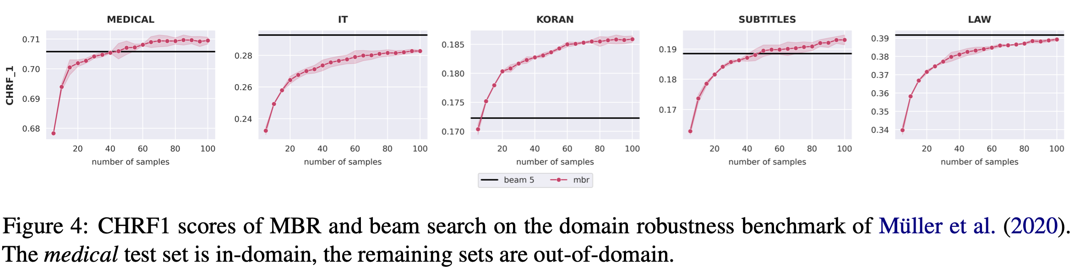
Domain robustness
MBR decoding has a higher domain robustness than beam search.

Slide 26
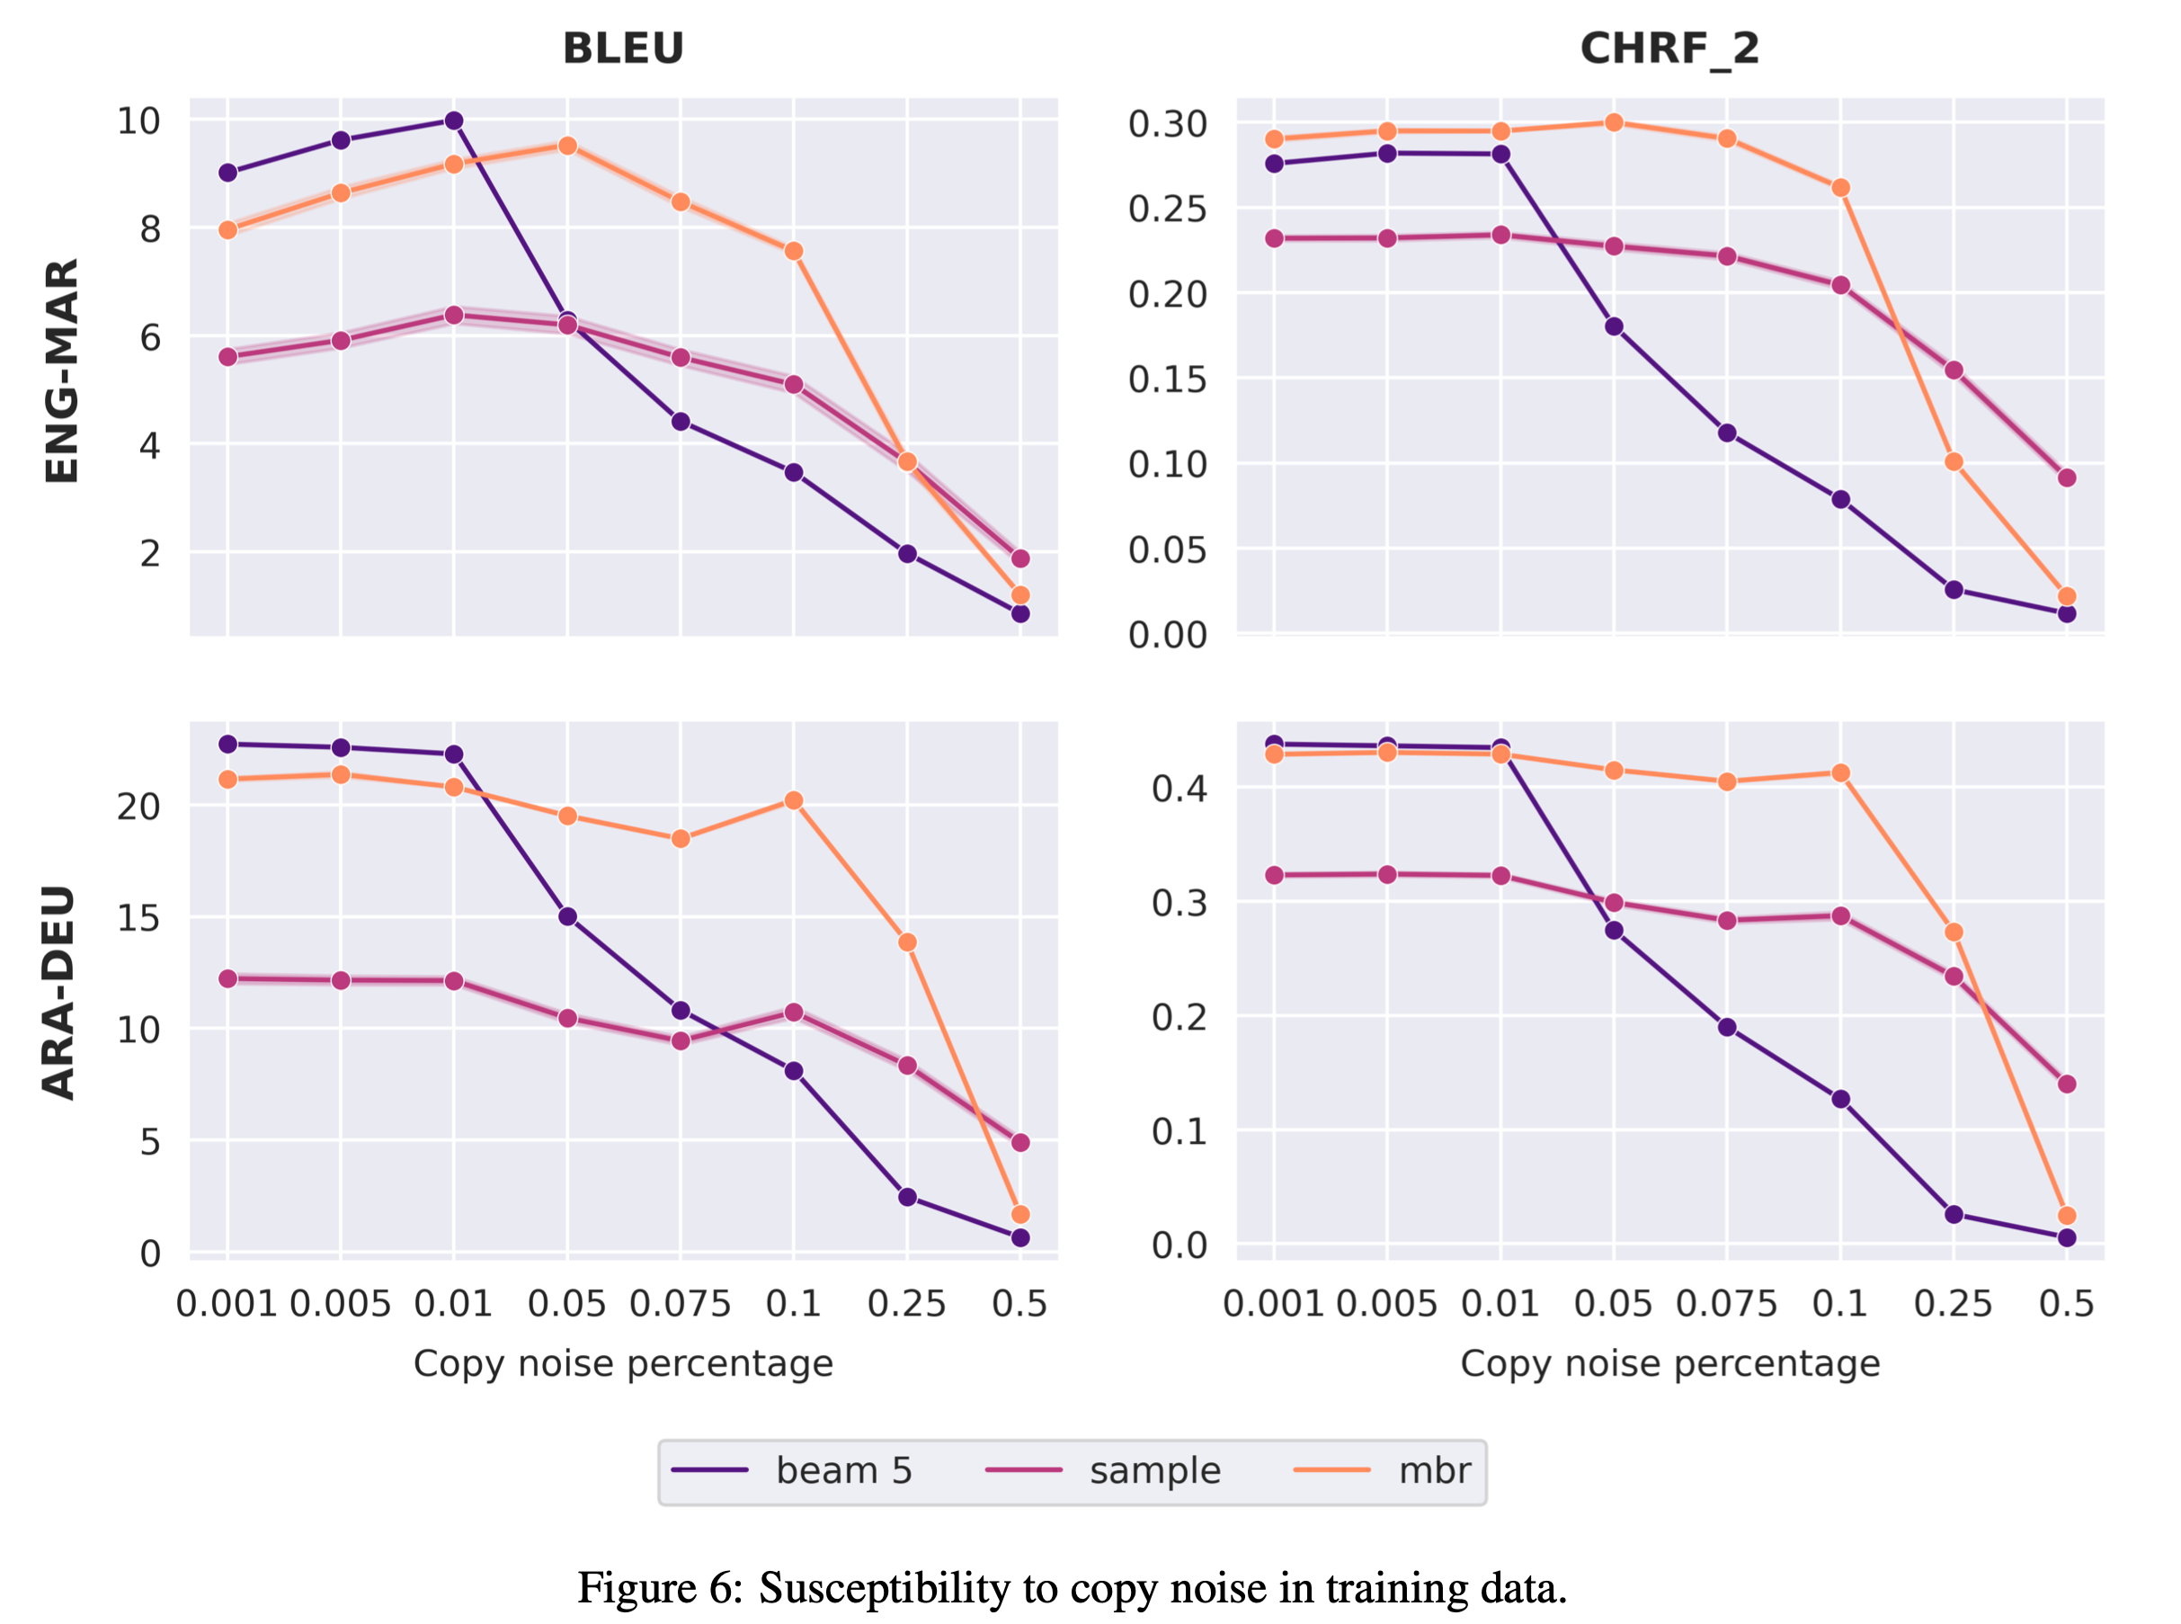
Copy noise
MBR is more robust to copy noise in the training data.

Slide 27
Thanks & QA

